Slide 1






SIM Global Education
CA3
ASSIGNMENT
Interaction Design
TEAM 3

Slide 2







OVERVIEW
The Team
Prototypes
Selected Area
Data Gathering Techniques
Interaction and Interface Types
Data Analysis Techniques
Lifecyce Model
Summary

Slide 3




THE TEAM
MICAH ANGELES
JESLYN HO
BRYCE SUMCAD
BILL ENG

Slide 4


SELECTED AREAS
Problems
Artificial Intelligence
Amazon
01
02
Automation
Privacy
Loss of Creativity
Discrimination
Recommendation Engine
Alexa-Voice Assistant
Amazon Go
Amazon One

Slide 5

SOLUTION
Interaction Types
Interface Types
Point and Click
Graphical User Interface (GUI)
Form Fill-in
Form Based Interface
Question Answer/ Dialogue Box
Voice User Interface (VUI)

Slide 6
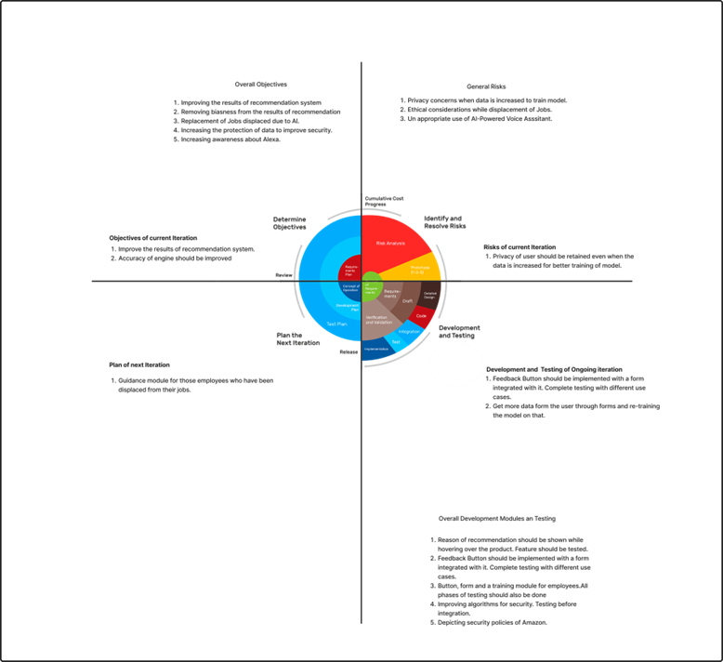
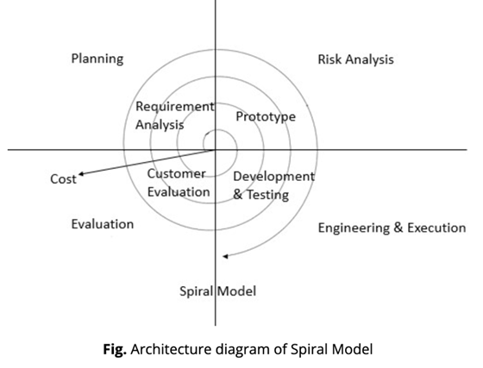

SPIRAL MODEL

Slide 7
SPIRAL MODEL

Slide 8
SPIRAL MODEL

Slide 9
SPIRAL MODEL

Slide 10
SPIRAL MODEL

Slide 11
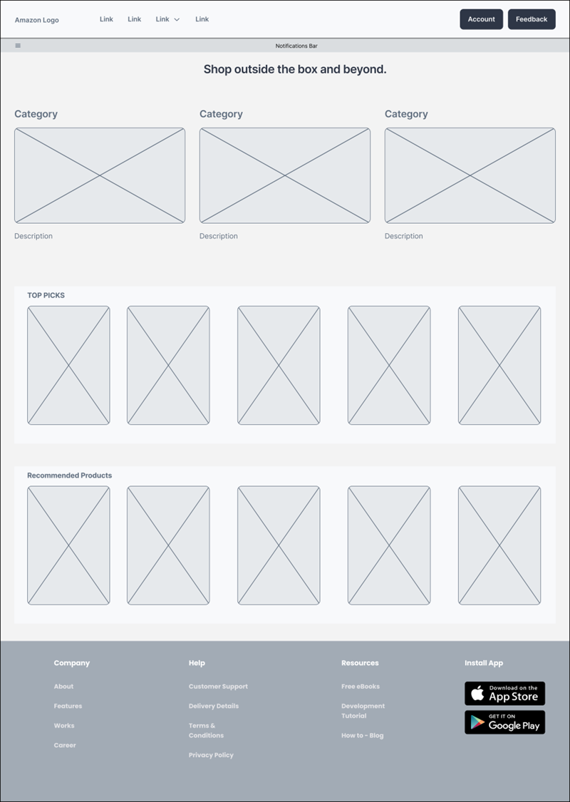
LOW FIDELITY PROTOTYPE

Slide 12
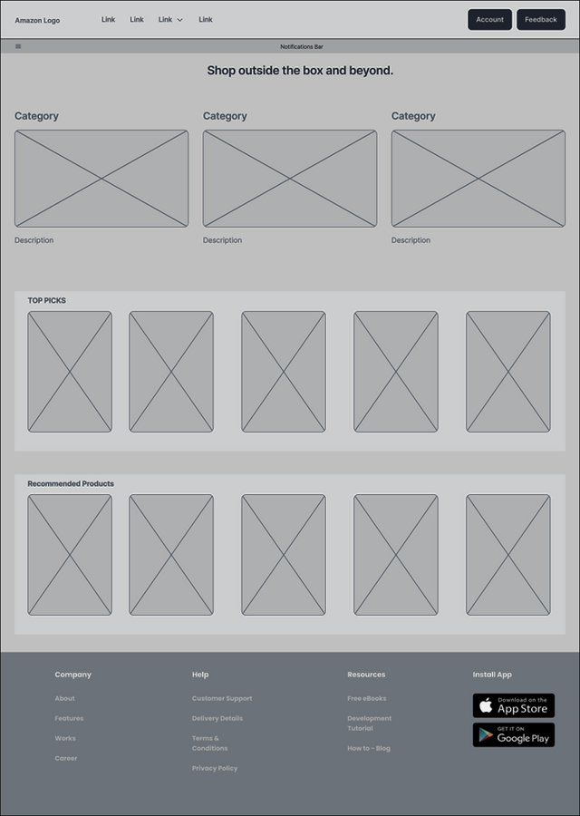
LOW FIDELITY PROTOTYPE

Slide 13
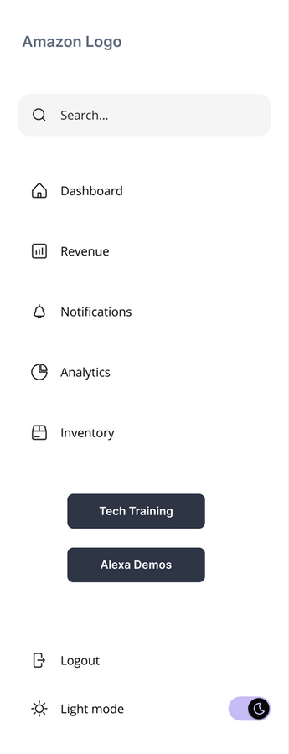
LOW FIDELITY PROTOTYPE

Slide 14
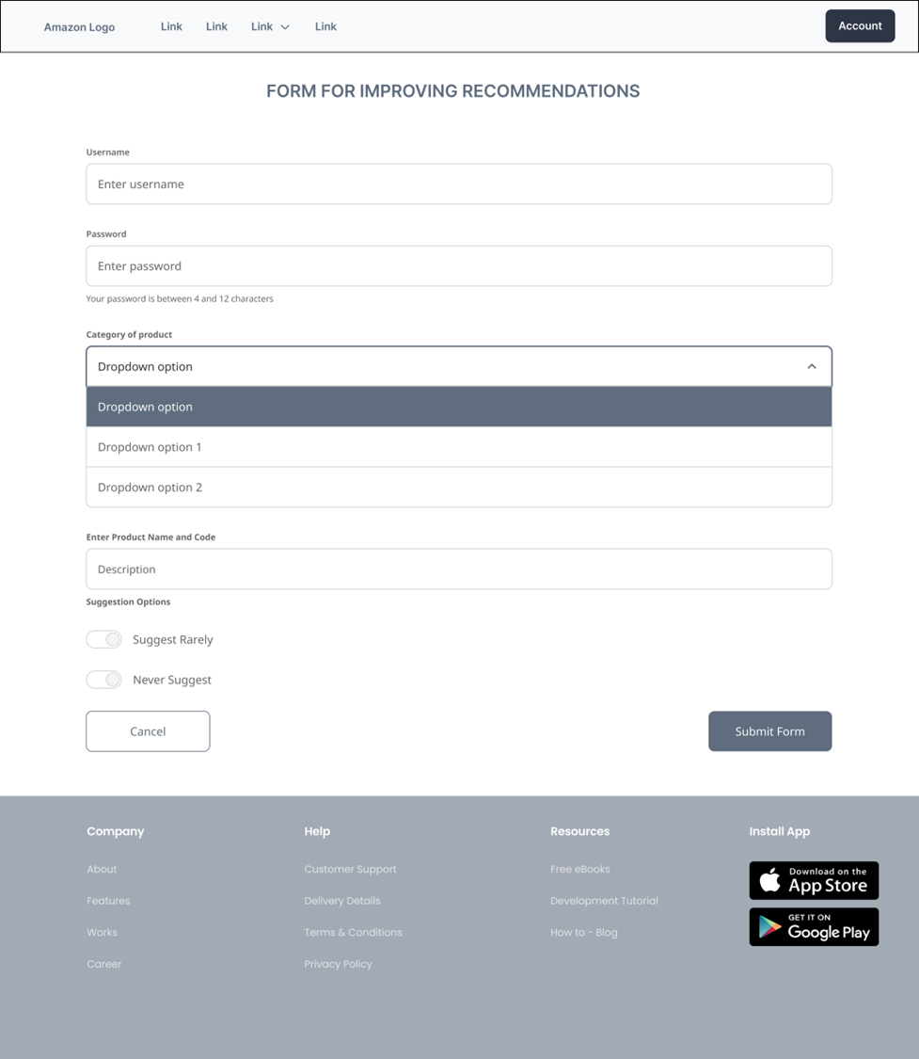
LOW FIDELITY PROTOTYPE

Slide 15
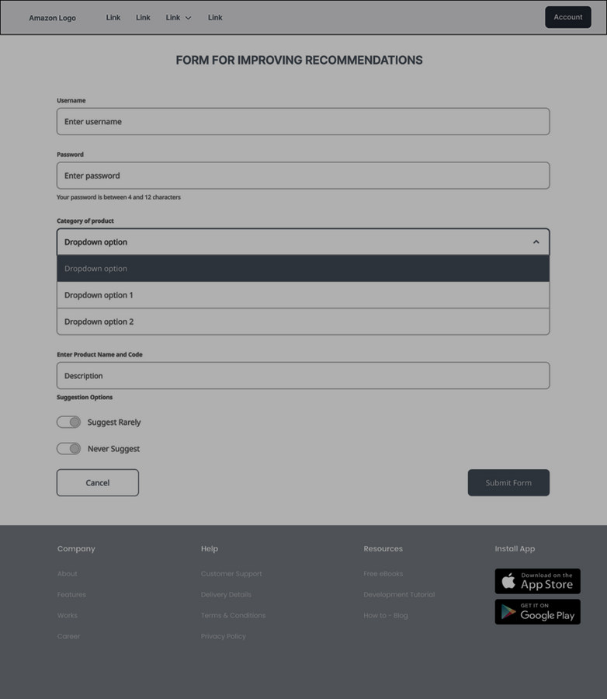
LOW FIDELITY PROTOTYPE

Slide 16
LOW FIDELITY PROTOTYPE

Slide 17
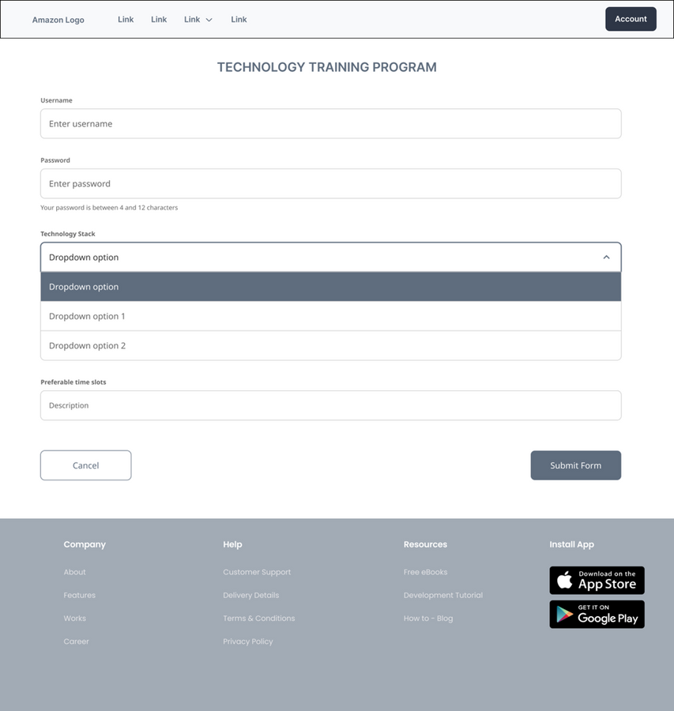
LOW FIDELITY PROTOTYPE

Slide 18
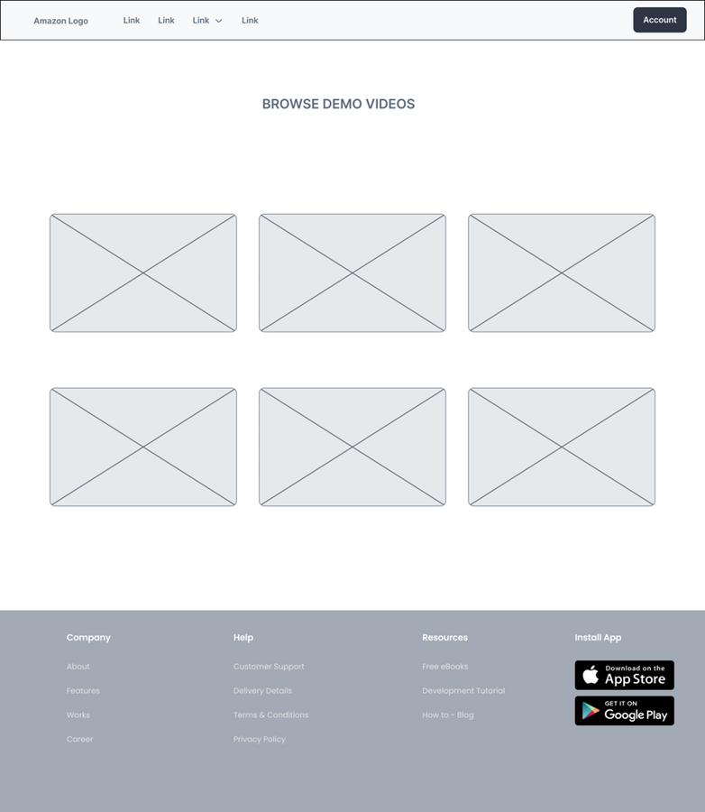
LOW FIDELITY PROTOTYPE

Slide 19

HIGH FIDELITY PROTOTYPE

Slide 20
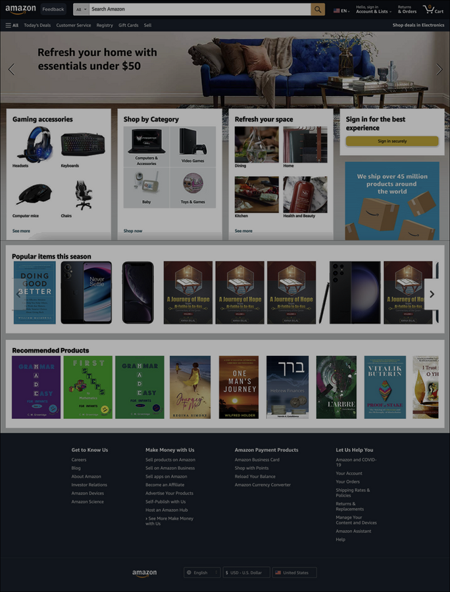
HIGH FIDELITY PROTOTYPE

Slide 21
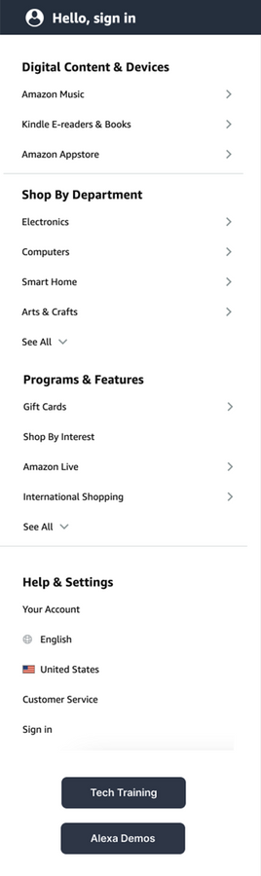
HIGH FIDELITY PROTOTYPE

Slide 22

HIGH FIDELITY PROTOTYPE

Slide 23

HIGH FIDELITY PROTOTYPE

Slide 24
HIGH FIDELITY PROTOTYPE

Slide 25

HIGH FIDELITY PROTOTYPE

Slide 26

HIGH FIDELITY PROTOTYPE

Slide 27
DATA GATHERING TECHNIQUES : SURVEY & QUESTIONNAIRE
Detailed Plan of Conduct
Defining the objectives of survey
Conducting the survey
Designing the questionnaire
Analysing the data
Identifying the Target Audience

Slide 28

DATA ANALYSIS TECHNIQUES
Qualitative Analysis
Quantitative Analysis
01
02
Grounded Theory
Content Analysis
Case Studies
Thematic Analysis
Histogram
Scatterplots
Box-Plots
DATA ANALYSIS TECHNIQUES

Slide 29
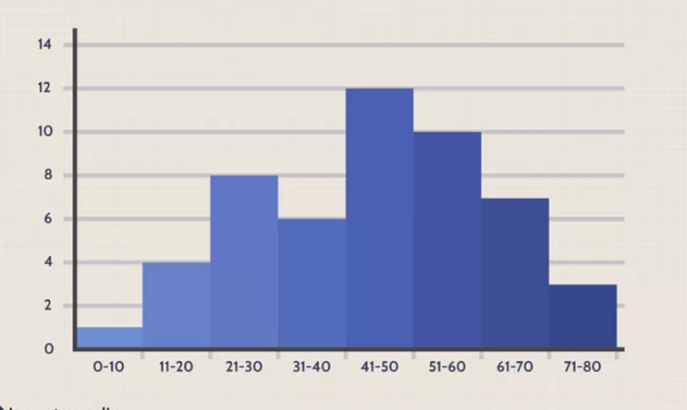
QUANTITATIVE ANALYSIS TECHNIQUES

Slide 30
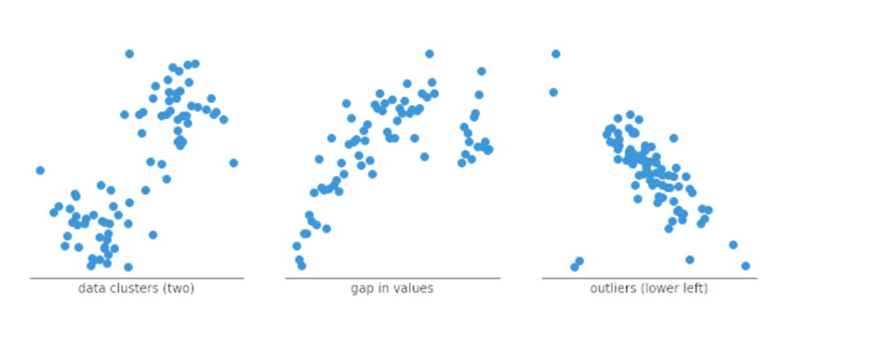
QUANTITATIVE ANALYSIS TECHNIQUES

Slide 31
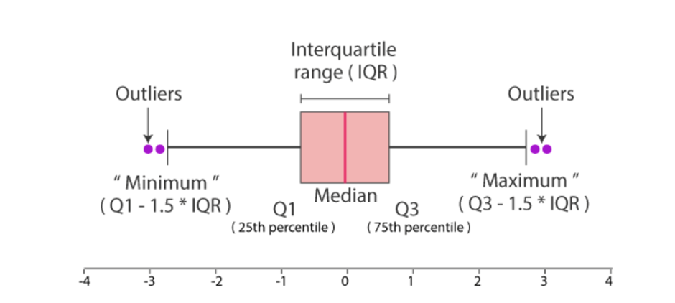
QUANTITATIVE ANALYSIS TECHNIQUES

Slide 32

THANK YOU

